Slide 1
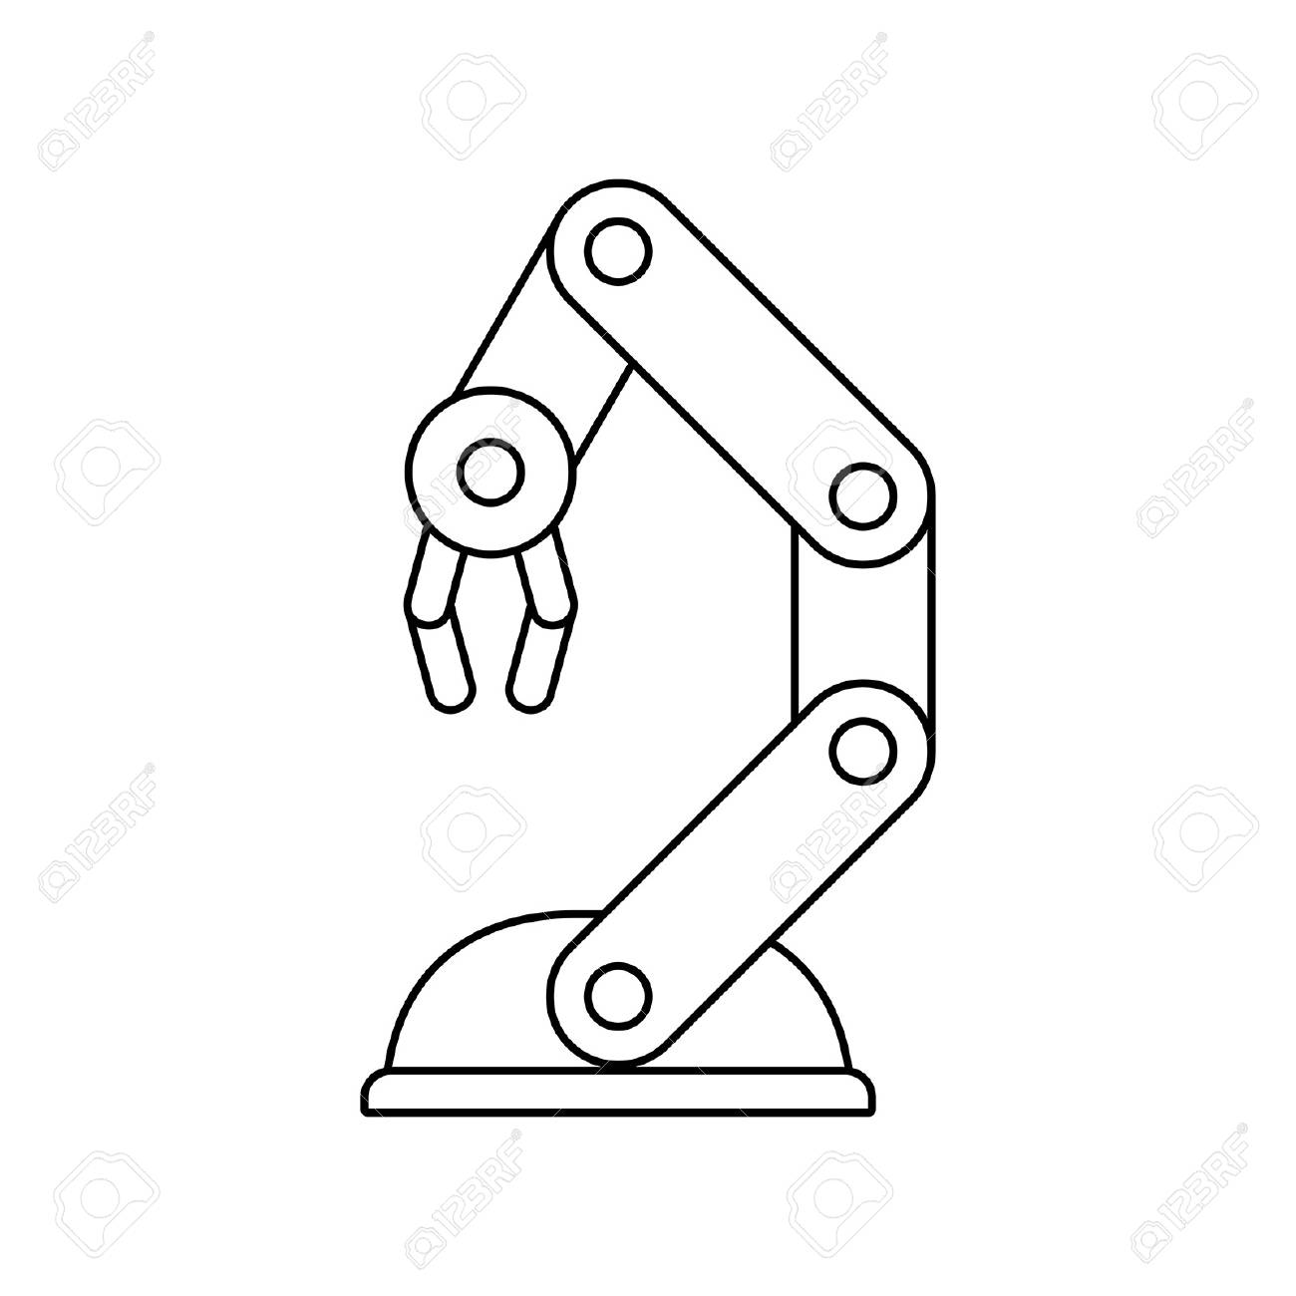
Hackathon Project
Team Mario Pilots
Richard Carter - Coder
Ilena Silva Varga – Builder 1
Ghanesh Denesh Chandrapaul – Builder 2
William Hackney – Presentation Designer
09-08 Dr. Romero-Ramirez

Slide 2
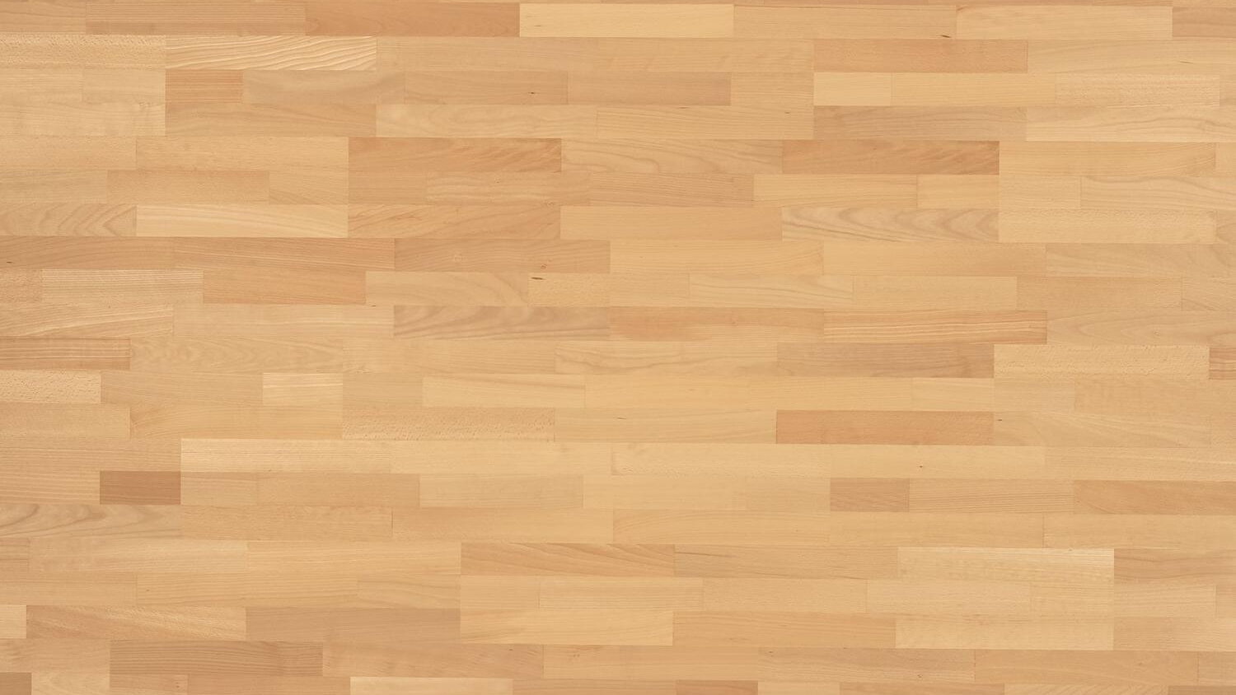
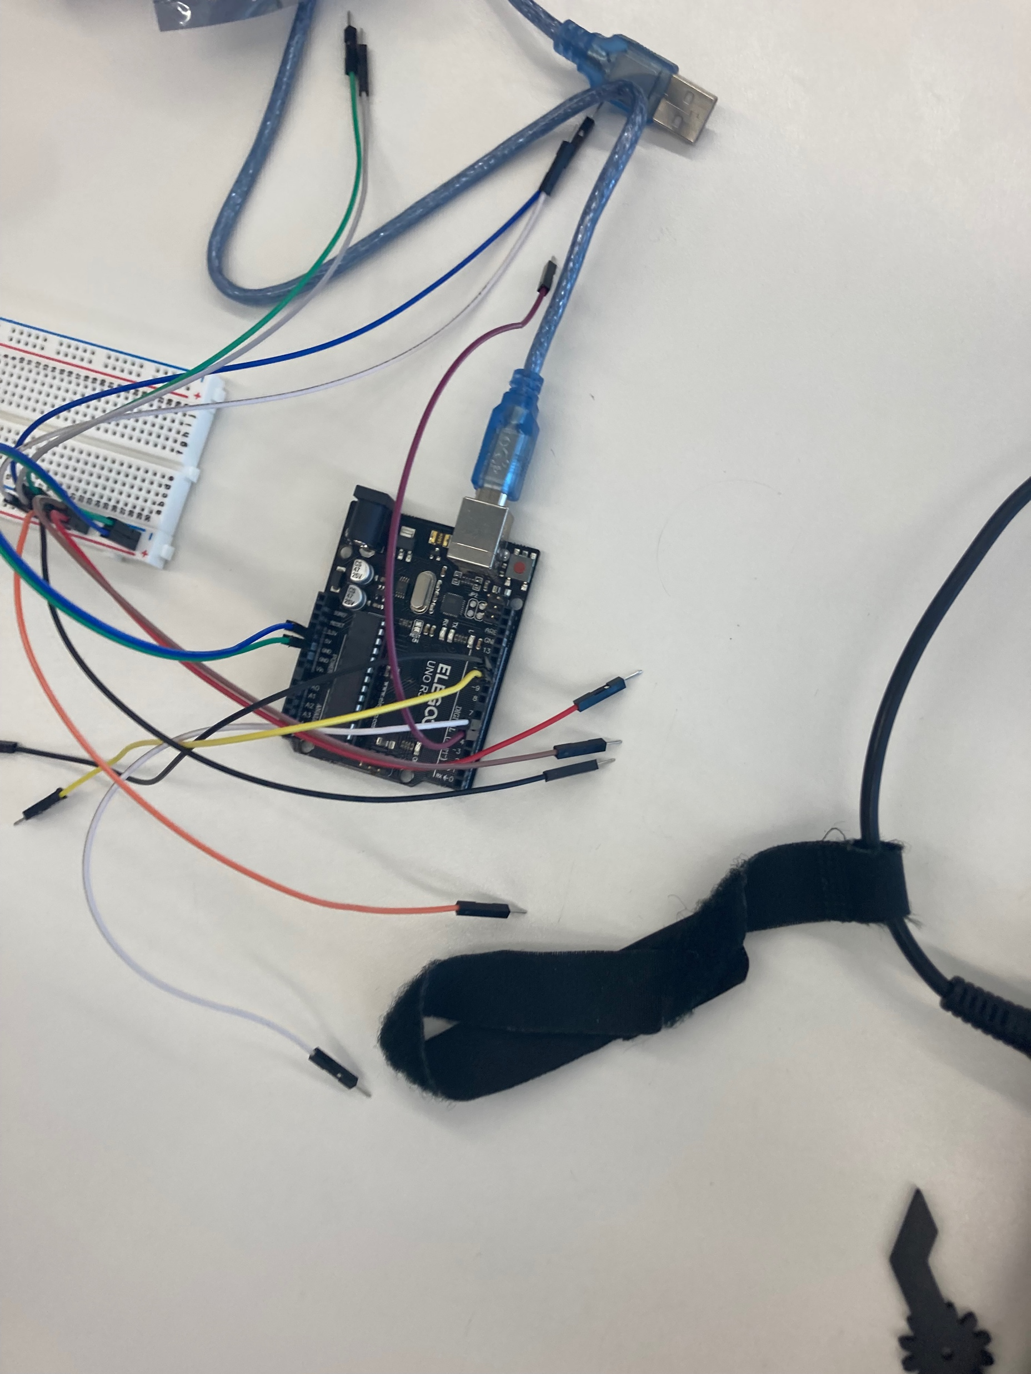
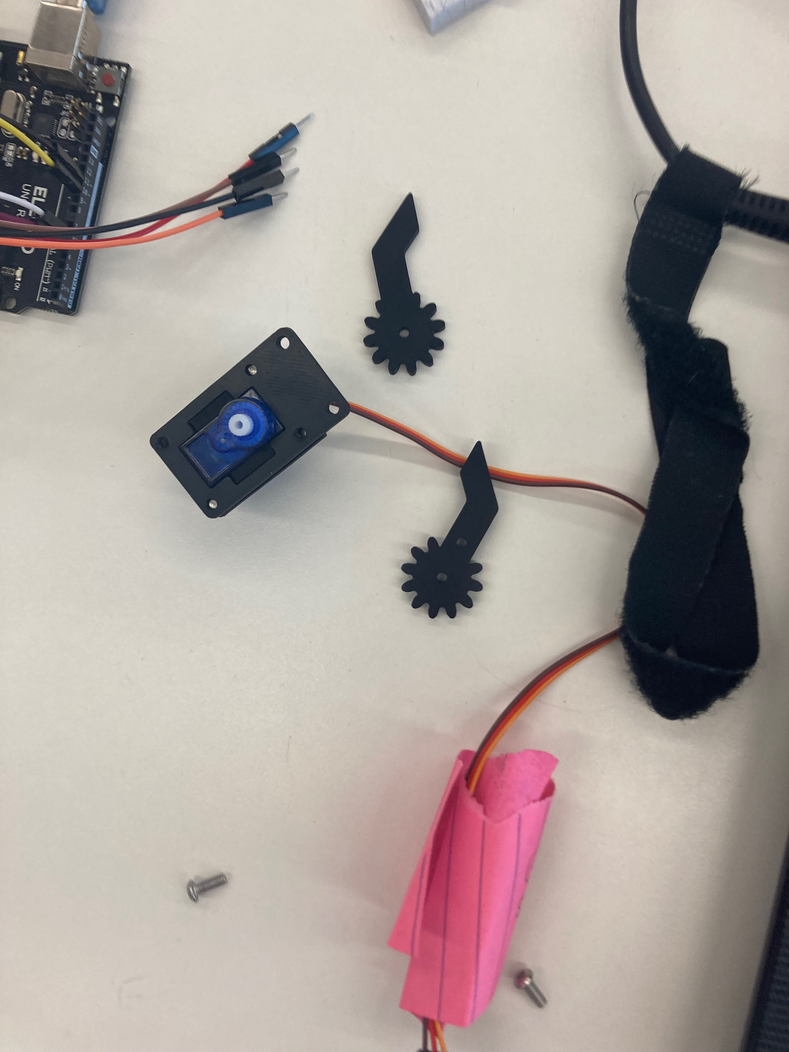
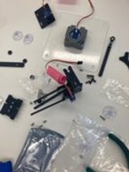
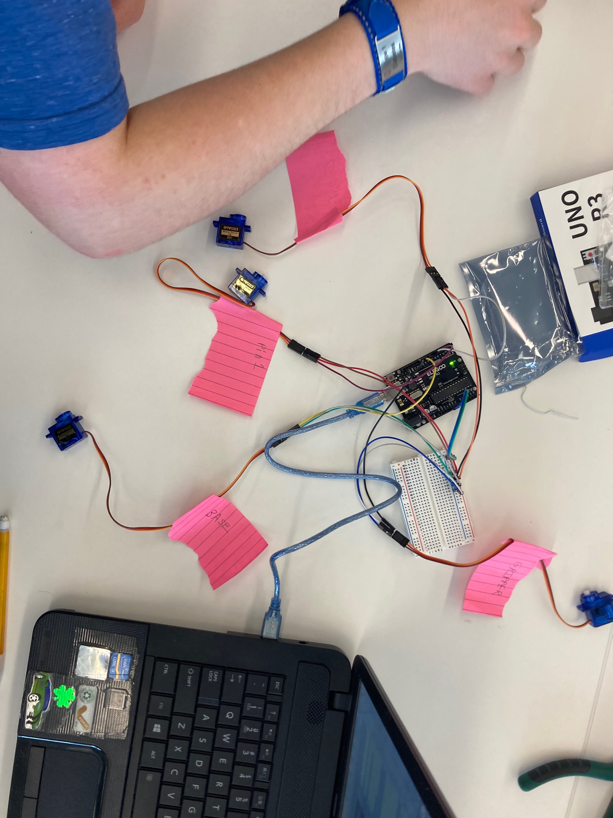
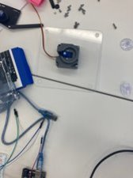
Timeline
Attaching the servos
Building the base
Building the sides
Calibrating the servos
Completed arm

Slide 3
Team Dynamics and Roles
Main Roles:
Richard: Coded the robot and calibrated the servos
Ilena: Focused on building majority of the robot
Ghanesh: Built the claw and helped with the body
William: Helped with the base and designed the presentation
While the servos were being calibrated, Ilena, Ghanesh and William focused on building as much of the robot as we could without the servos. This mainly determined our roles afterward.
After the servos were calibrated, Ilena and Ghanesh continued building the robot, while William designed the presentation and Richard coded the robot.

Slide 4
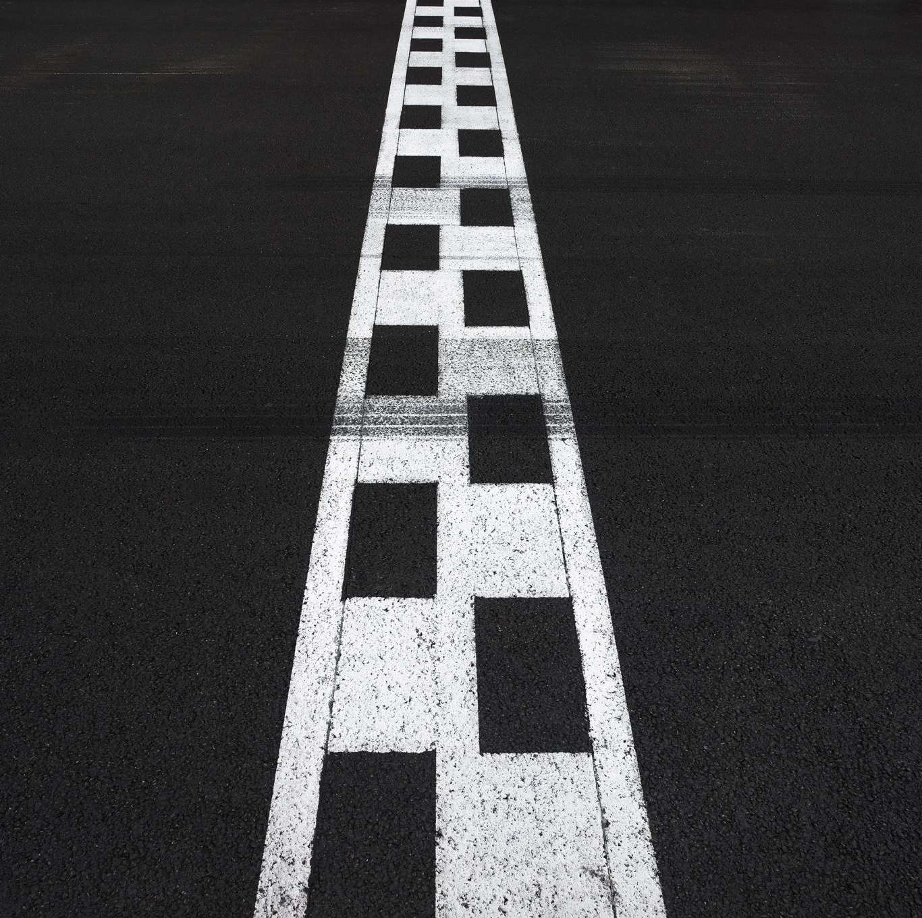
Roadblocks and Challenges
The Easy Parts:
Organizing the parts
Setting up the servos
Most of the coding
Challenges:
Building and coding the claw
Instructions were difficult to follow
Figuring out the correct parts to use
Screws
The servos took too much power to run properly

Slide 5

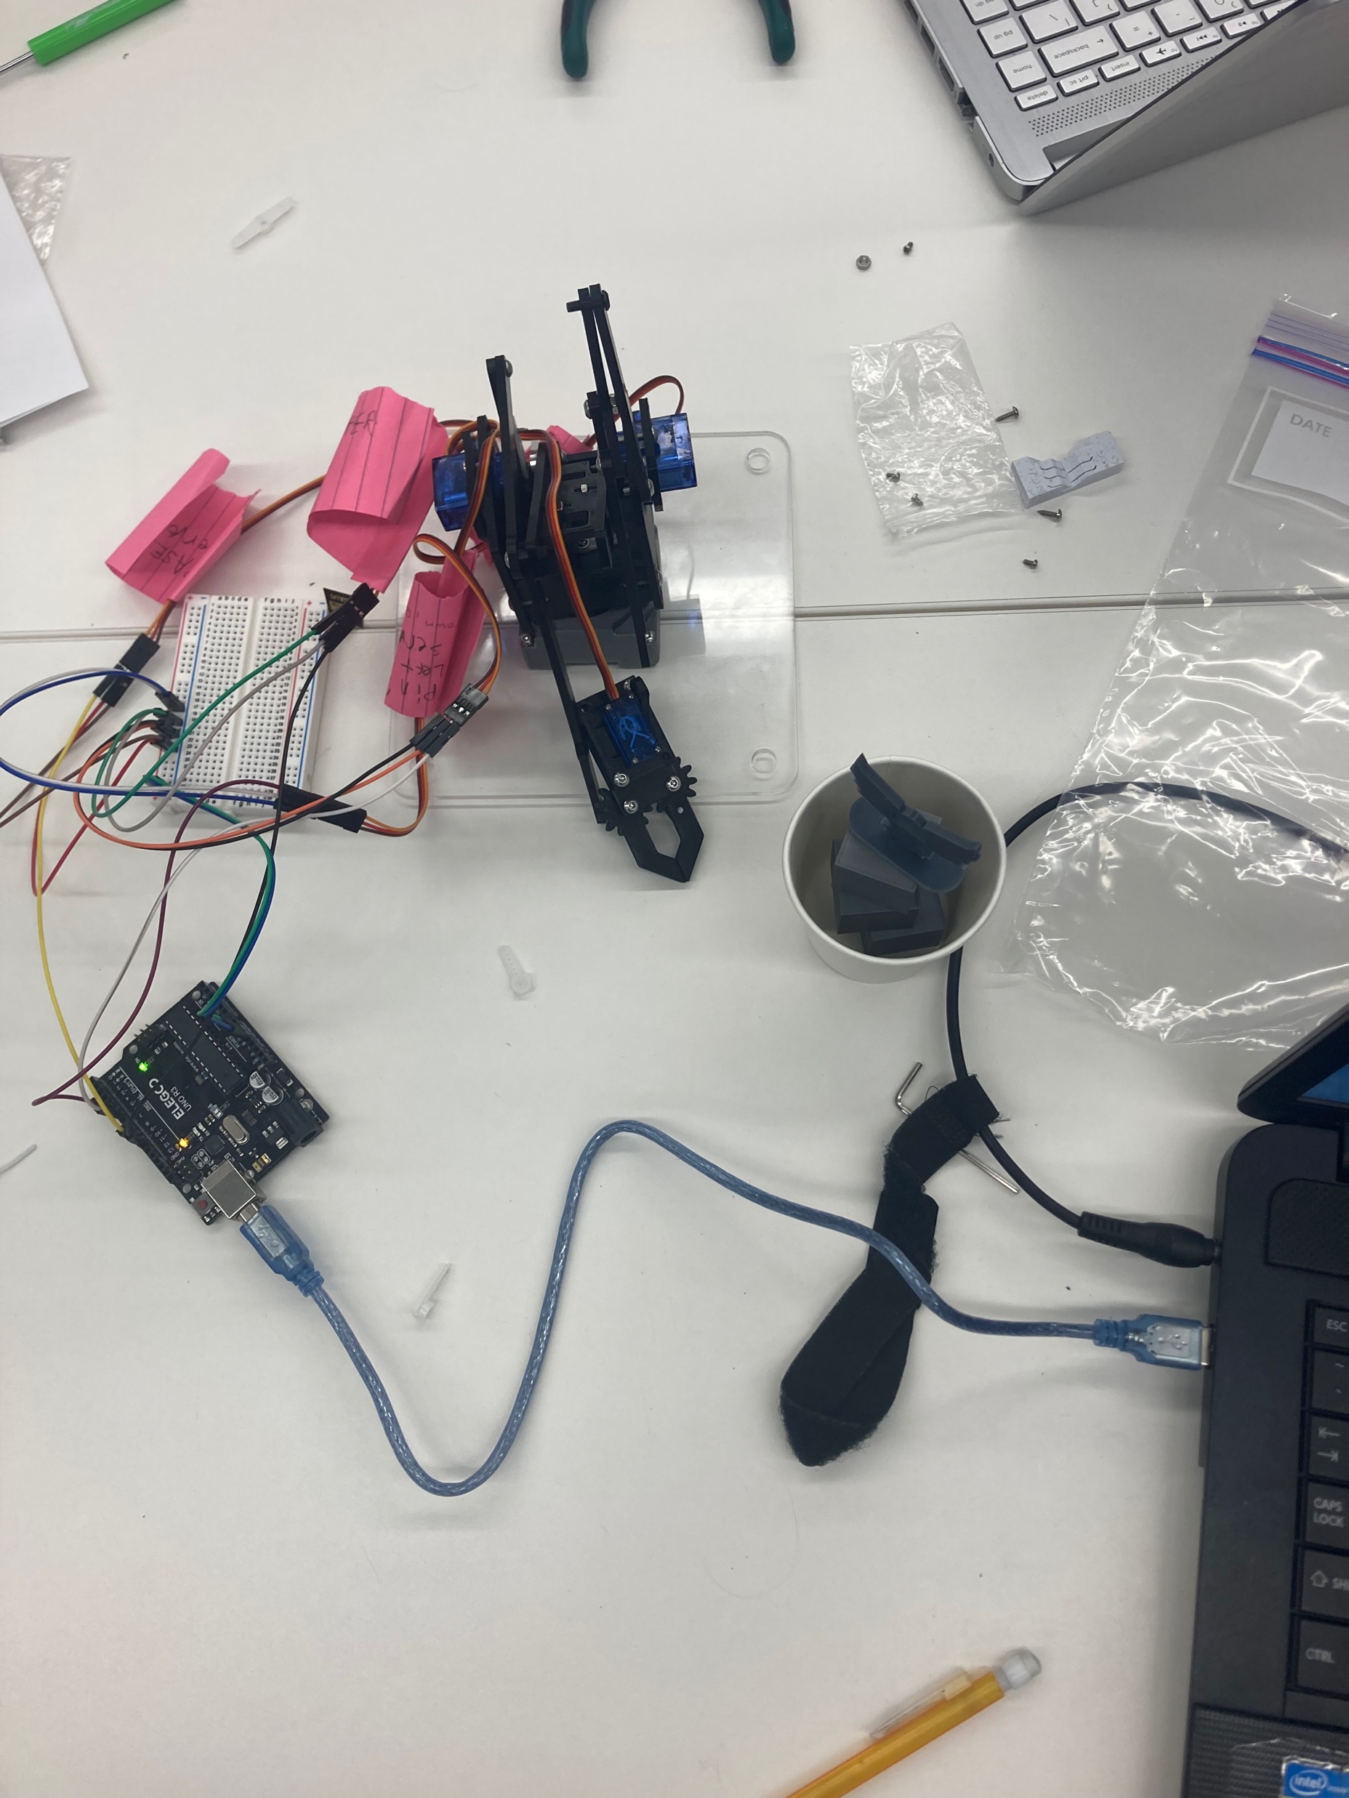
Team Experience
Overall, we are proud that we made a decent attempt at building the robot, even if it did not work perfectly. We each worked as efficiently as we could manage, and tried building as much as we could. Looking back at the process, understanding the instructions and making sure we were always following them properly is where we had the most room for improvement, because this is what caused many of the problems that we encountered.

